Slide 1
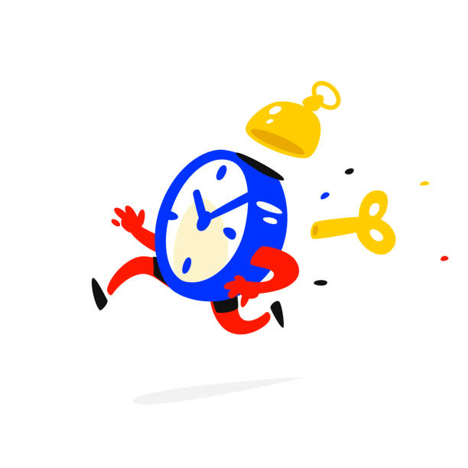
AGENDĂ
Prezentare
Activitate
Energizer
Main activity 🍽️
Reflection
3. Closing

Slide 2
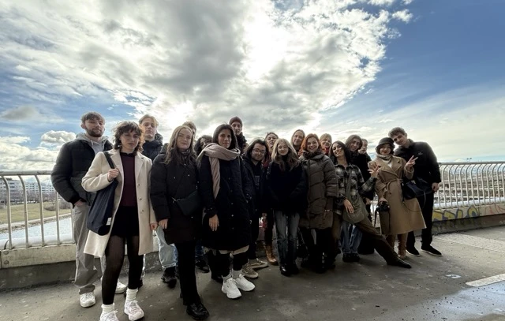
PEMEHECON
Protect the Environment and your Mental Health with your Connection with Nature
Agreement No: 2025-1-AT01-KA153-YOU-000297129
https://pemehecon.webnode.page/

Slide 3

Activity Dates: 18th of February – 1st of March 2026, including travelling dates.
Professional Development Activity: Training Course
Activity: Training in Vienna, Austria, for 21 youth workers (3 youth workers from each organisation, 7 organisations) in Environment and Forest Theatre with Non-Formal Educational Activities.

Slide 4
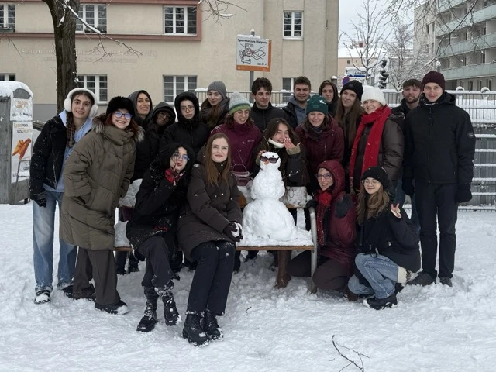
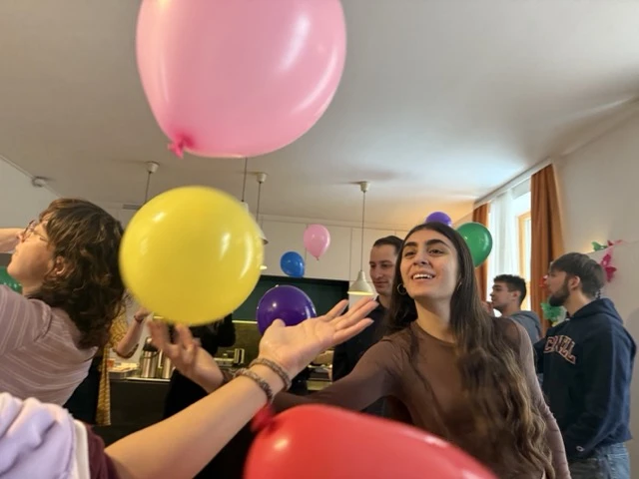
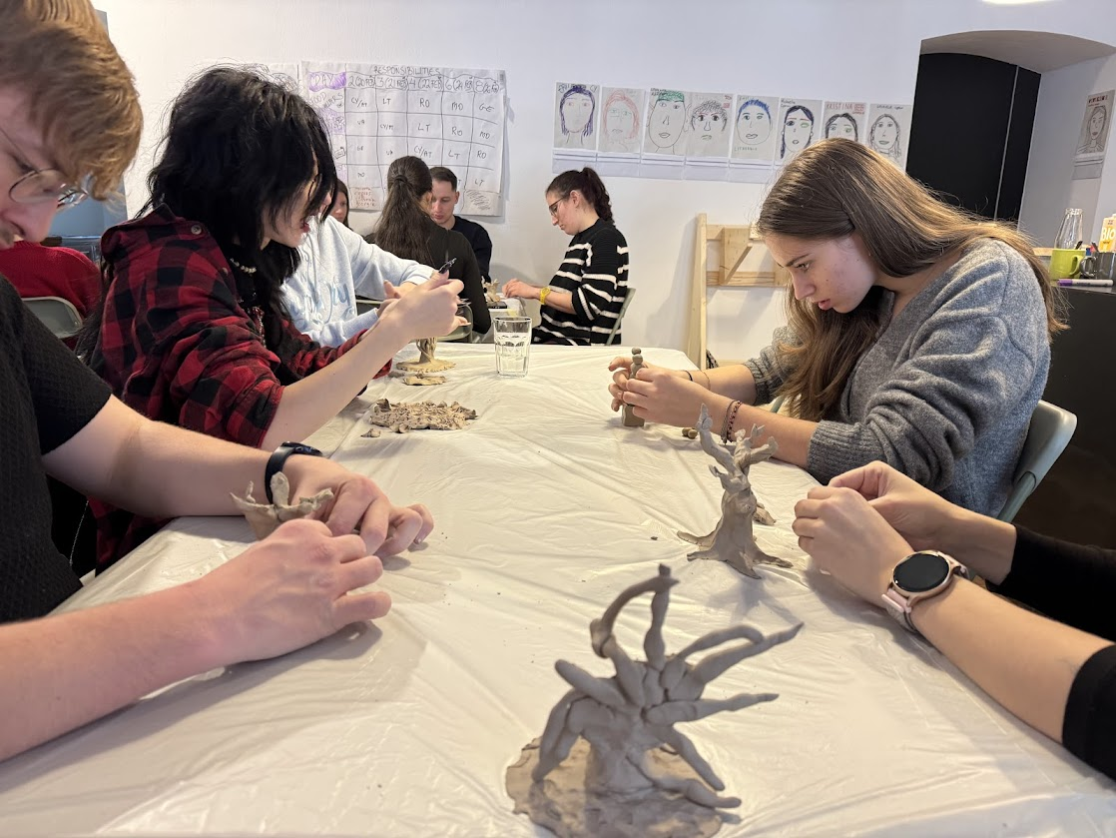
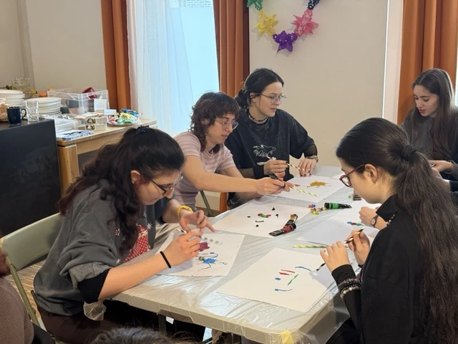
MENTAL HEALTH
NATURE
THEATRE
ELEMENTS
ART
YOGA
Temele proiectului
și activități

Slide 5
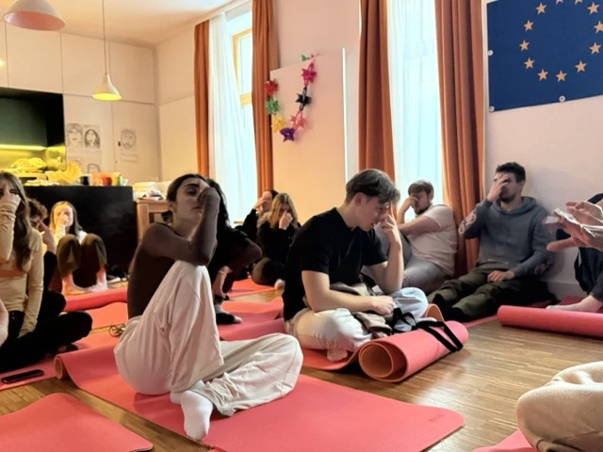
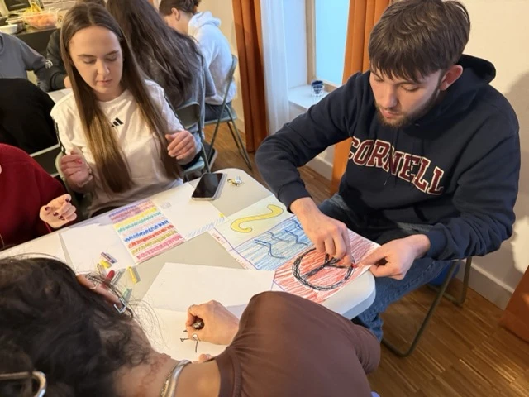
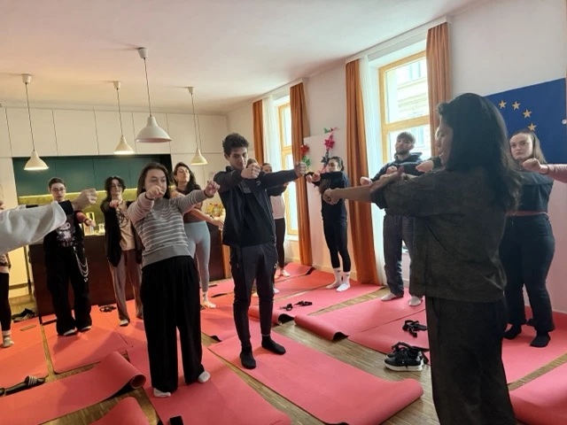
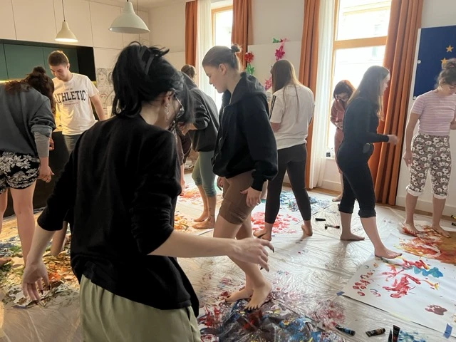
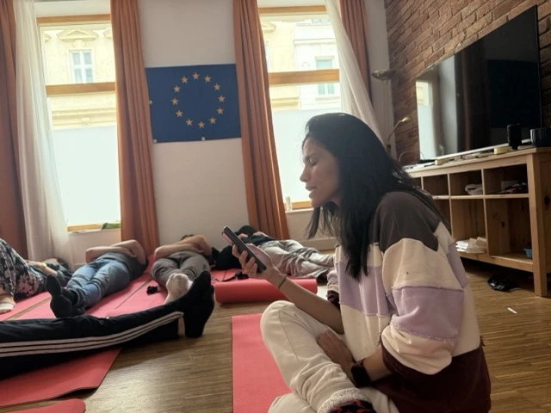
MENTAL HEALTH
NATURE
THEATRE
ELEMENTS
ART
YOGA
Temele proiectului
și activități

Slide 6
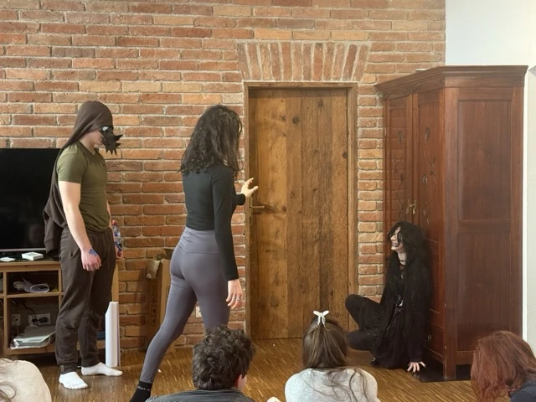
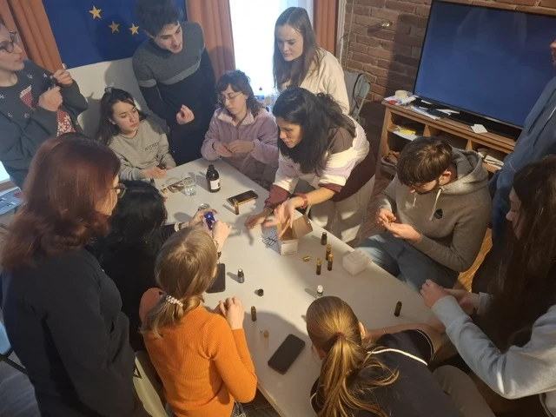
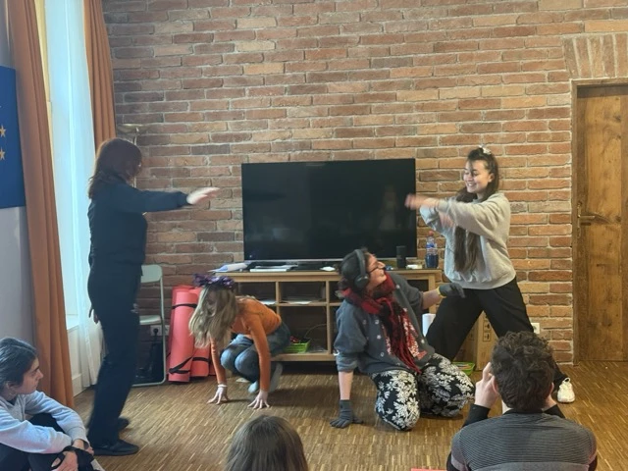
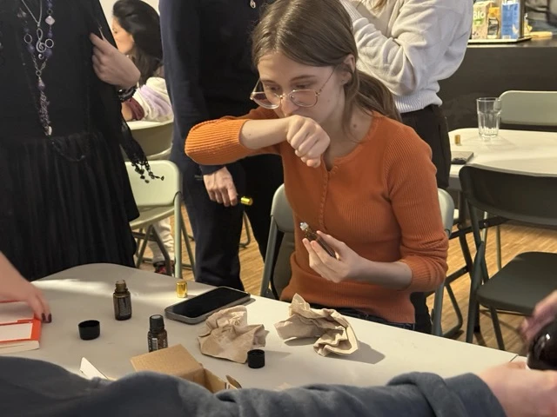
MENTAL HEALTH
NATURE
THEATRE
ELEMENTS
ART
YOGA
Temele proiectului
și activități

Slide 7

VIDEO

Slide 8
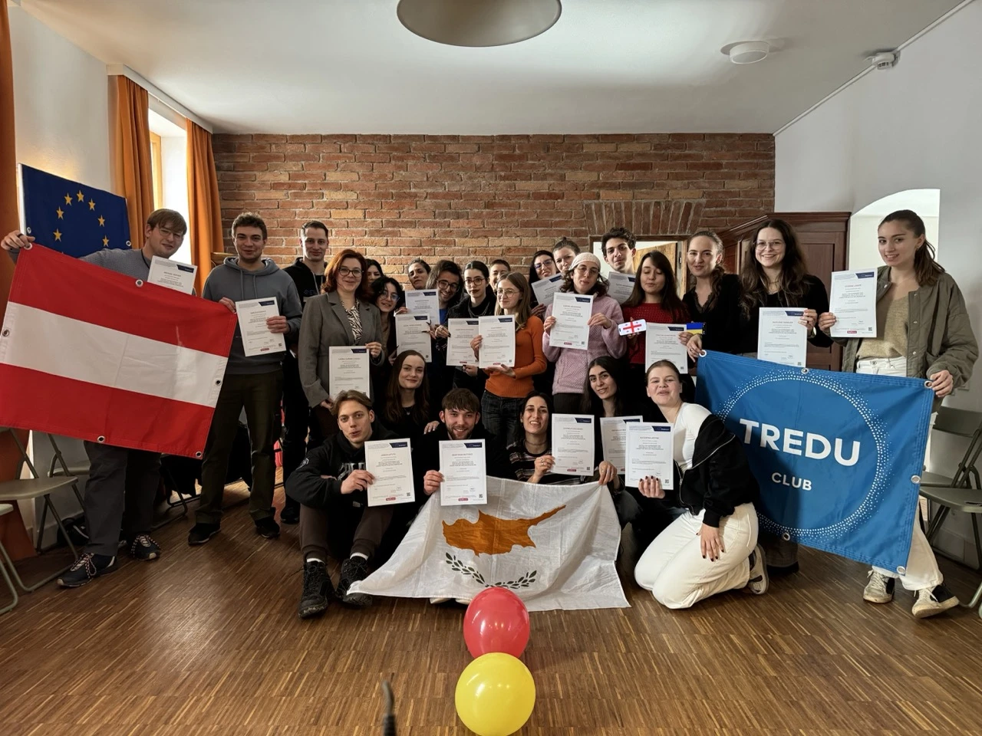

Slide 9


Slide 10

Youth Exchanges
Training Courses
DiscoverEU
Erasmus+ University
European Solidarity Corps
Erasmus Mundi
https://erasmus-plus.ec.europa.eu/opportunities

Slide 11


